Slide 1
Boat Building – wc 15.06.2020

Slide 2
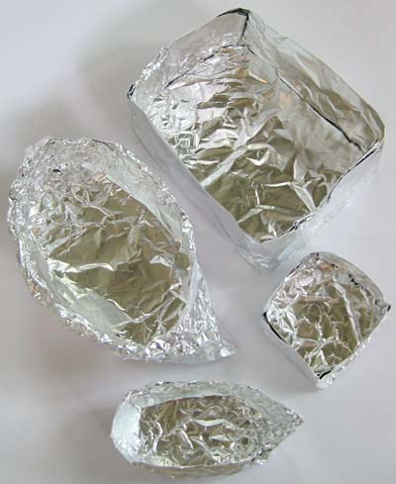
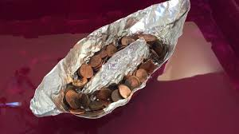
Task:
Use sheets of tinfoil (all the same size) to create boats with a different design.
Hypothesis– which one do you think will hold the most weight (the pennies)?
Place each of the boats in the same container of water. Do any sink with no extra weight? Add a penny to each of the boats one at a time. Which is first to sink? Which holds the most weight? What is the difference in shape in the most successful boat and the least successful boat?

Slide 3
Why does this happen?
How can you increase the surface area of the boat – how does this affect the density and then buoyancy of your boat?
The larger the surface area of the boat, the less the density. The mass of the object (how heavy it is) is spread out across the surface, allowing up thrust from the water to counter the mass and the object can float more successfully.
Click the link to watch a clip to support your understanding:

