Slide 1
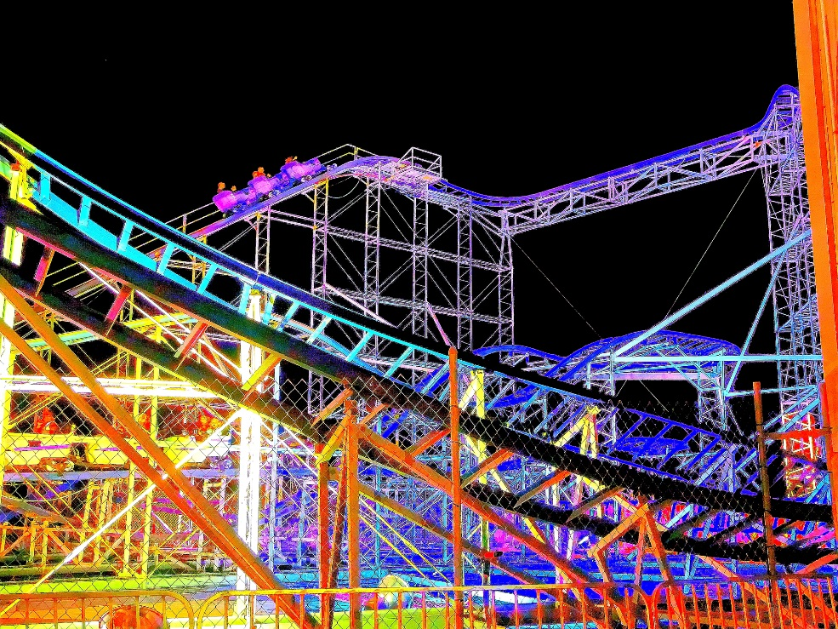
Learning Outcome:
Recognise and use similes and metaphors.

Slide 2
Similes and metaphors share some common traits ...
Notes:
https://www.flickr.com/photos/kim_carpenter_nj/7565537700

Slide 3
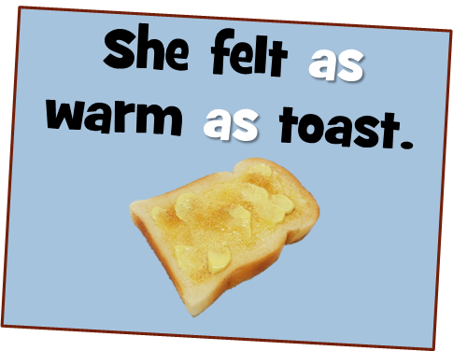
What are Similes?
A simile is a direct comparison and uses the word ‘like’ or ‘as’ in the comparison.

Slide 4
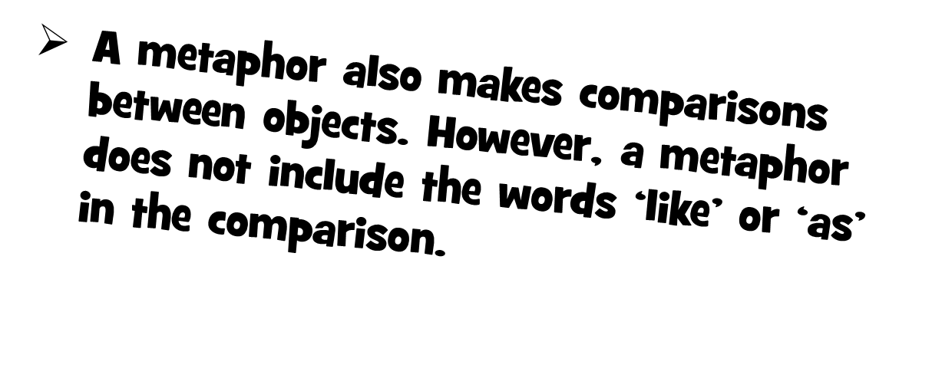
Notes:
https://www.flickr.com/photos/kim_carpenter_nj/7565537700

Slide 5
This metaphor compares life with a rollercoaster. It says life is a roller coaster. It has its ups and downs and can be scary and yet exciting. Much is conveyed in a few words.
Notes:
https://www.flickr.com/photos/kim_carpenter_nj/7565537700

Slide 6
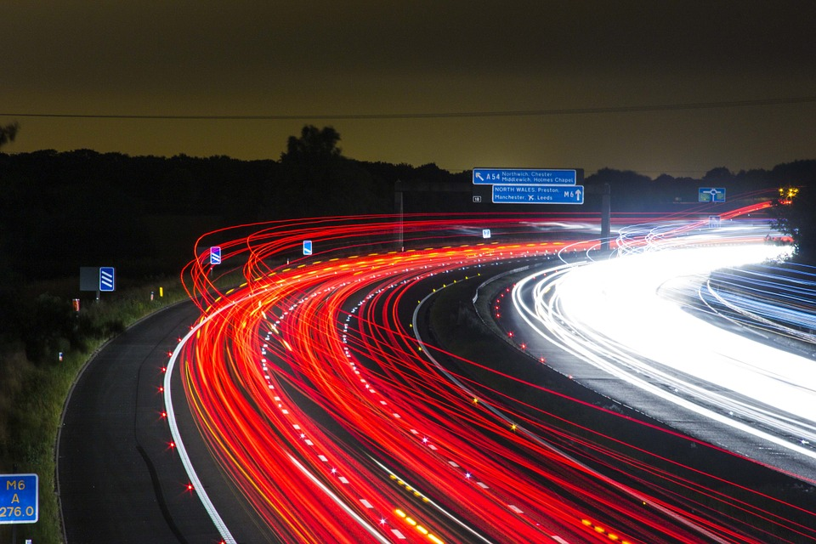
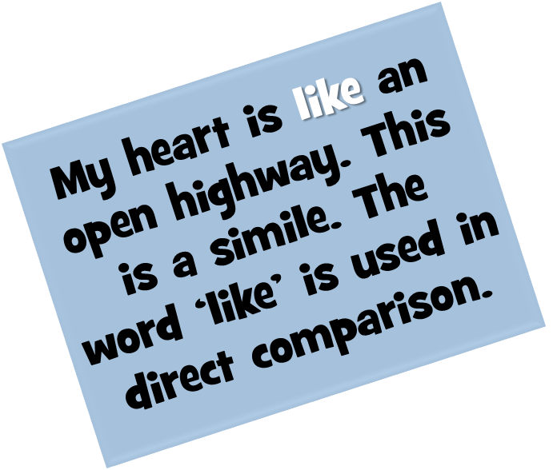

Slide 7
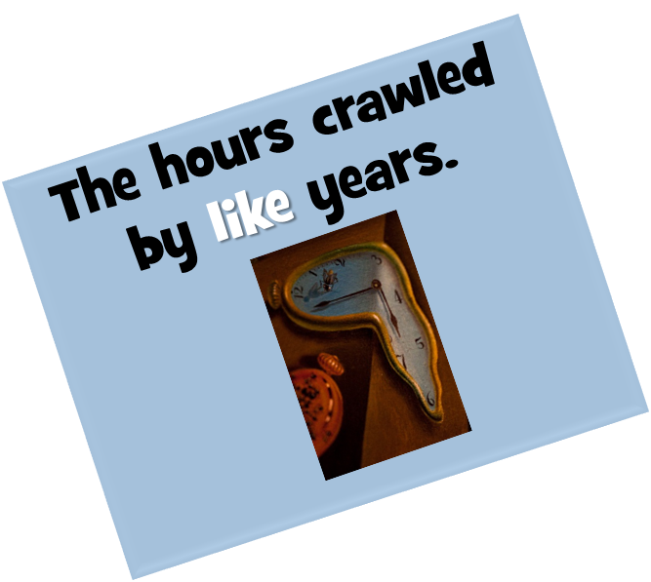
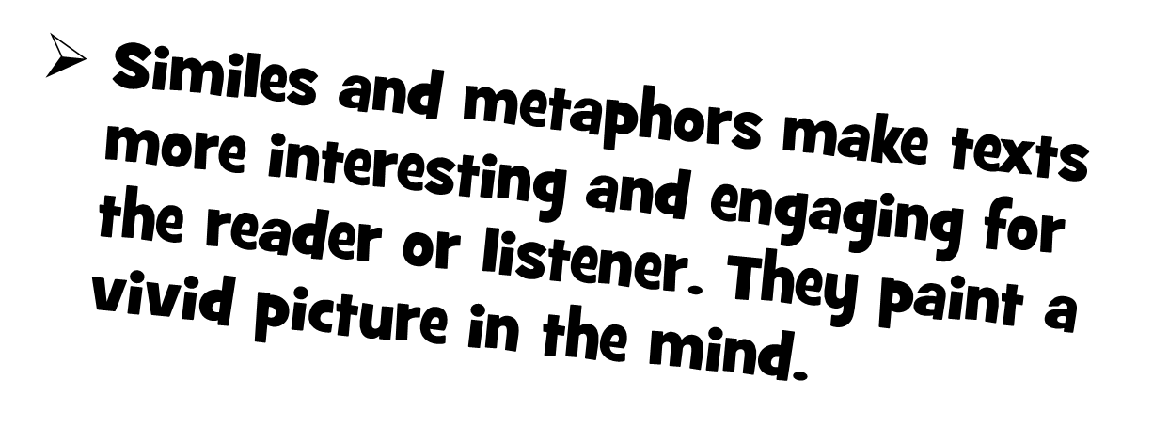

Slide 8
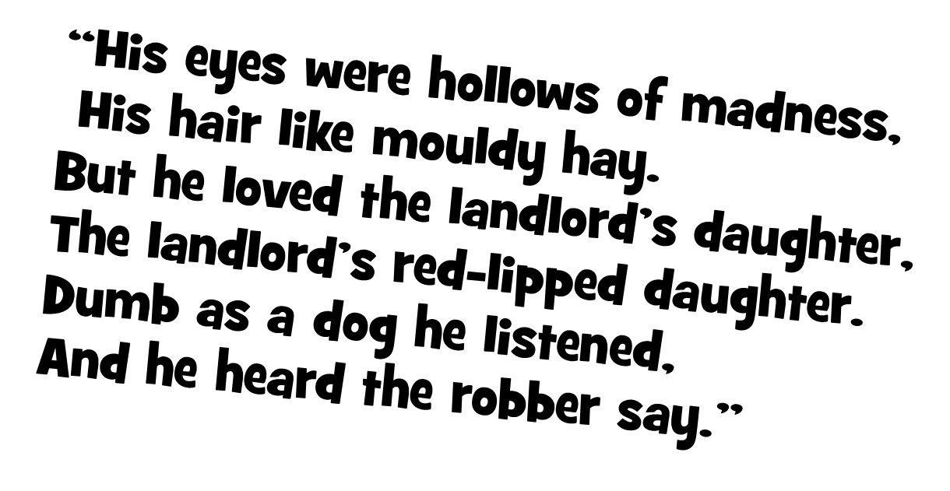

Slide 9
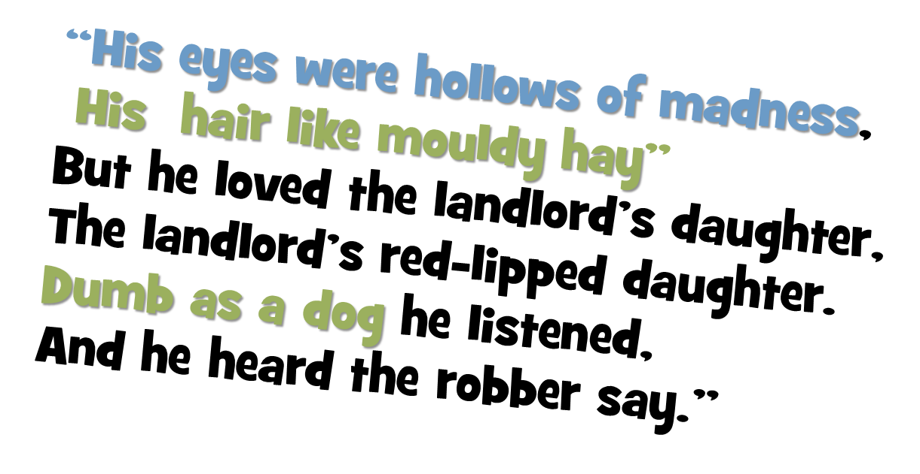
“The Highwayman” by Alfred Noyes

