Slide 1
Week 4
What other features and activities can be seen around coasts, mostly the UK?

Slide 2
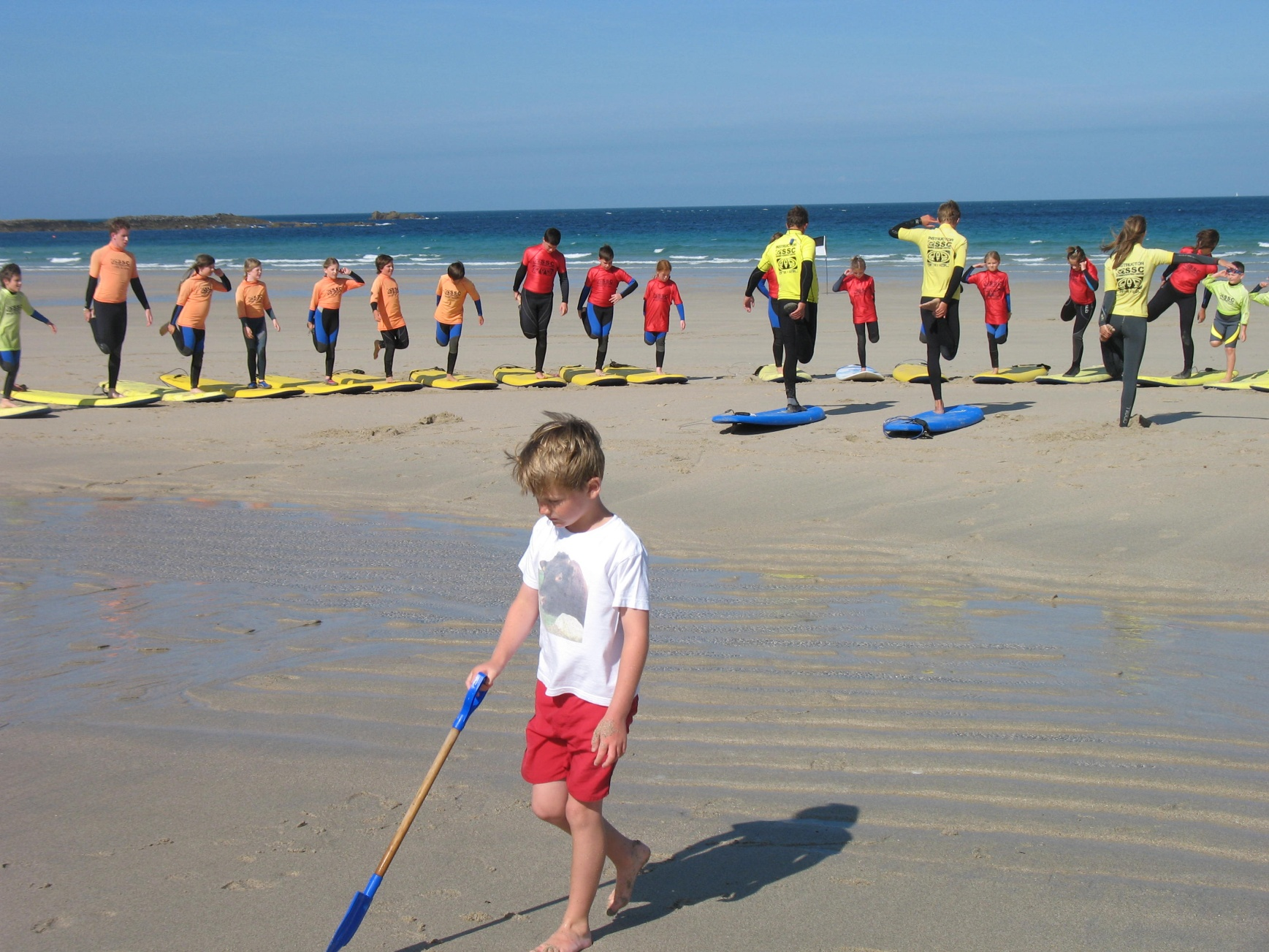
Notes:
A beginners’ surfing lesson at Sennen, Cornwall

Slide 3
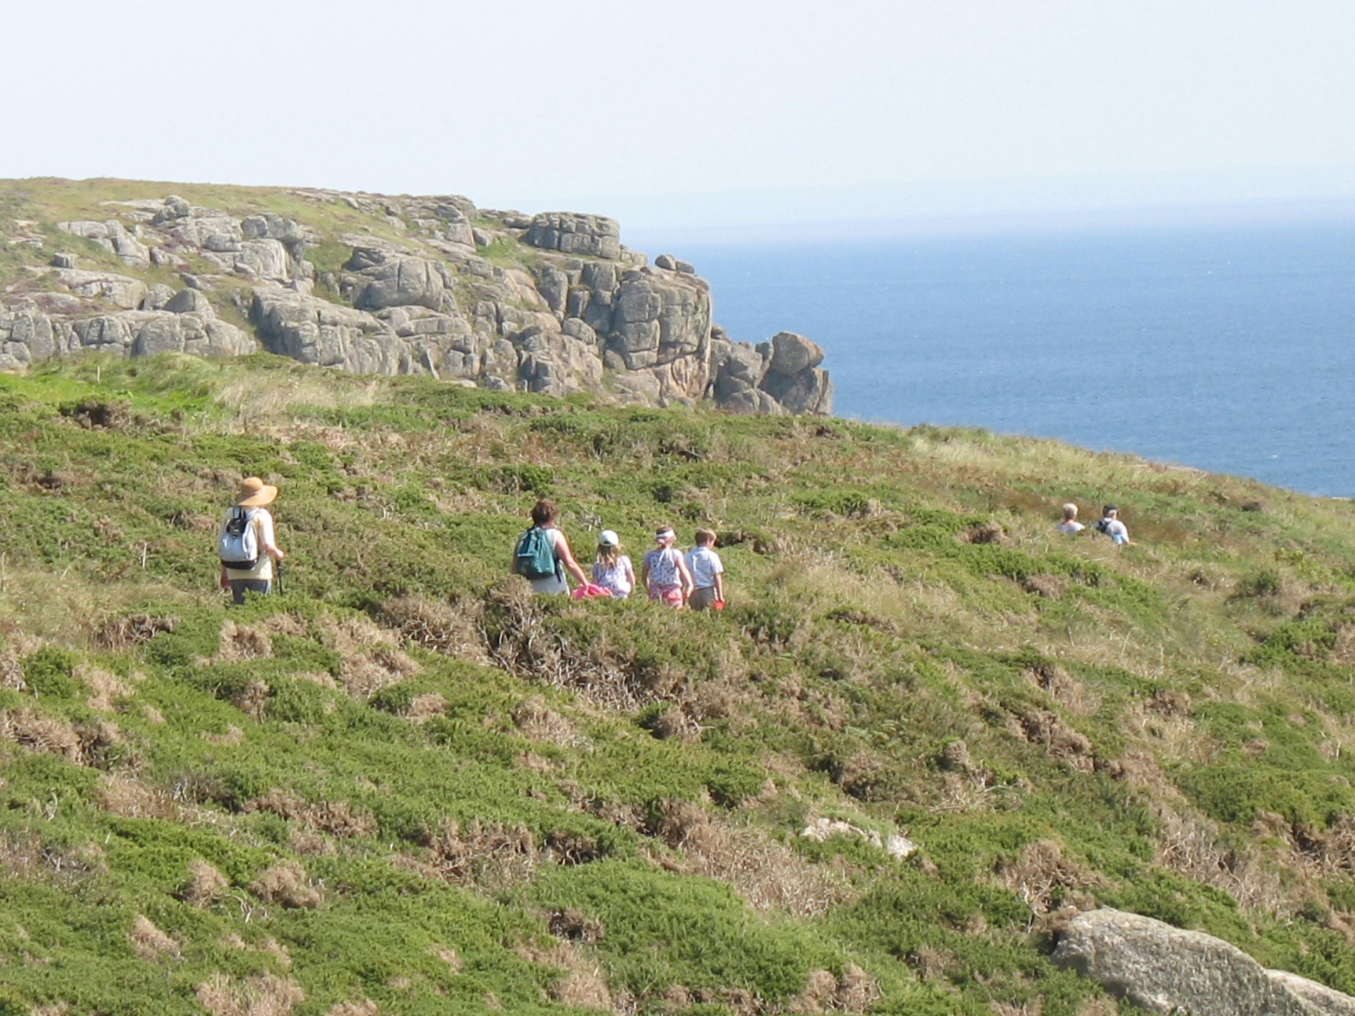
Notes:
Walking on the coast path near Cape Cornwall.

Slide 4
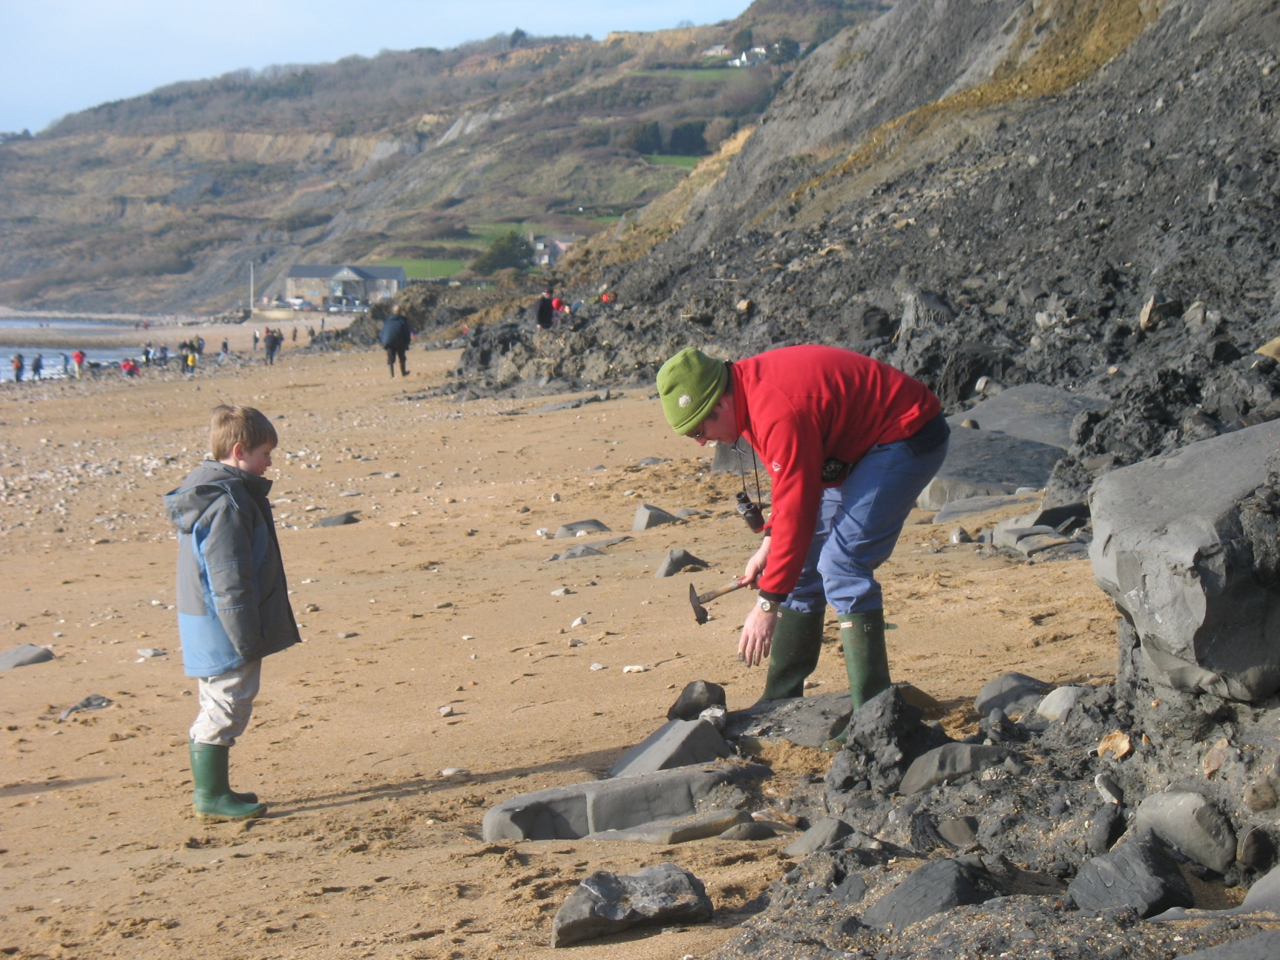
Notes:
Hunting for fossils at Charmouth, Dorset.

Slide 5
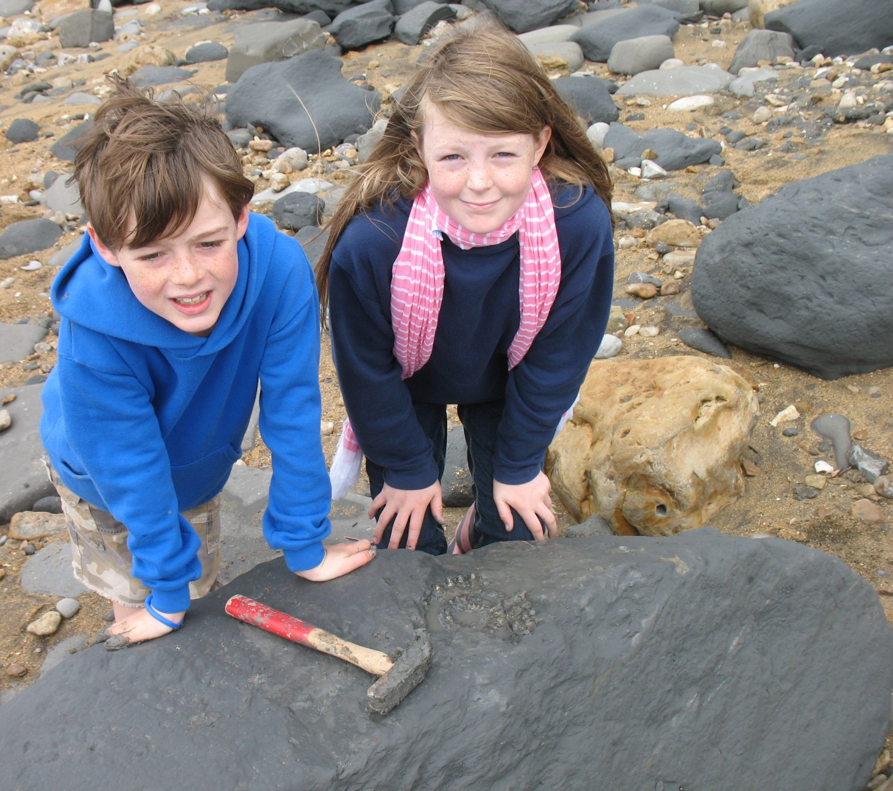
Notes:
Inspecting ammonite fossils found at Charmouth.

Slide 6
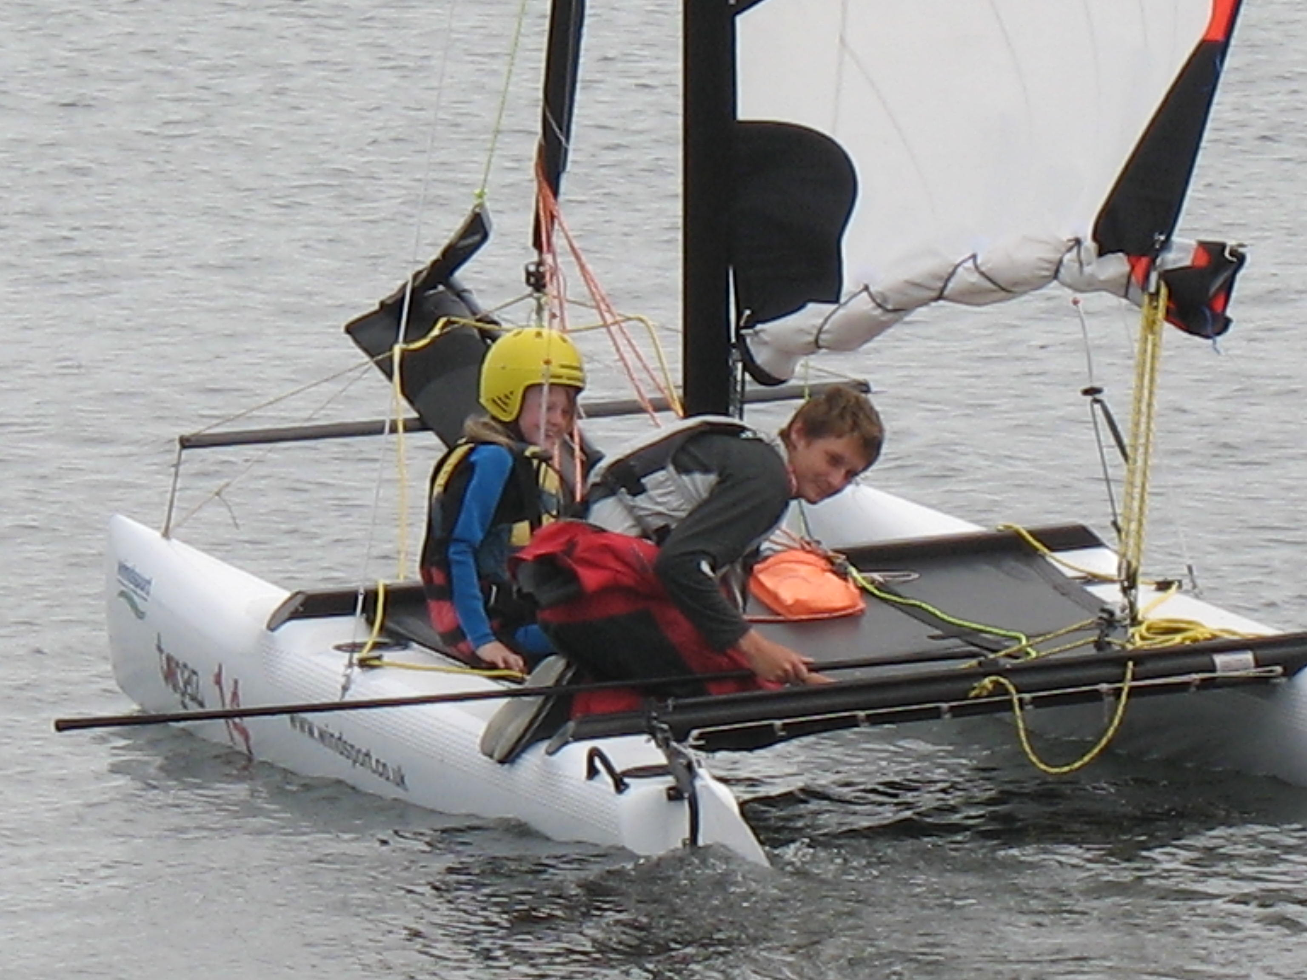
Notes:
Learning to sail at Mylor, Cornwall.

Slide 7
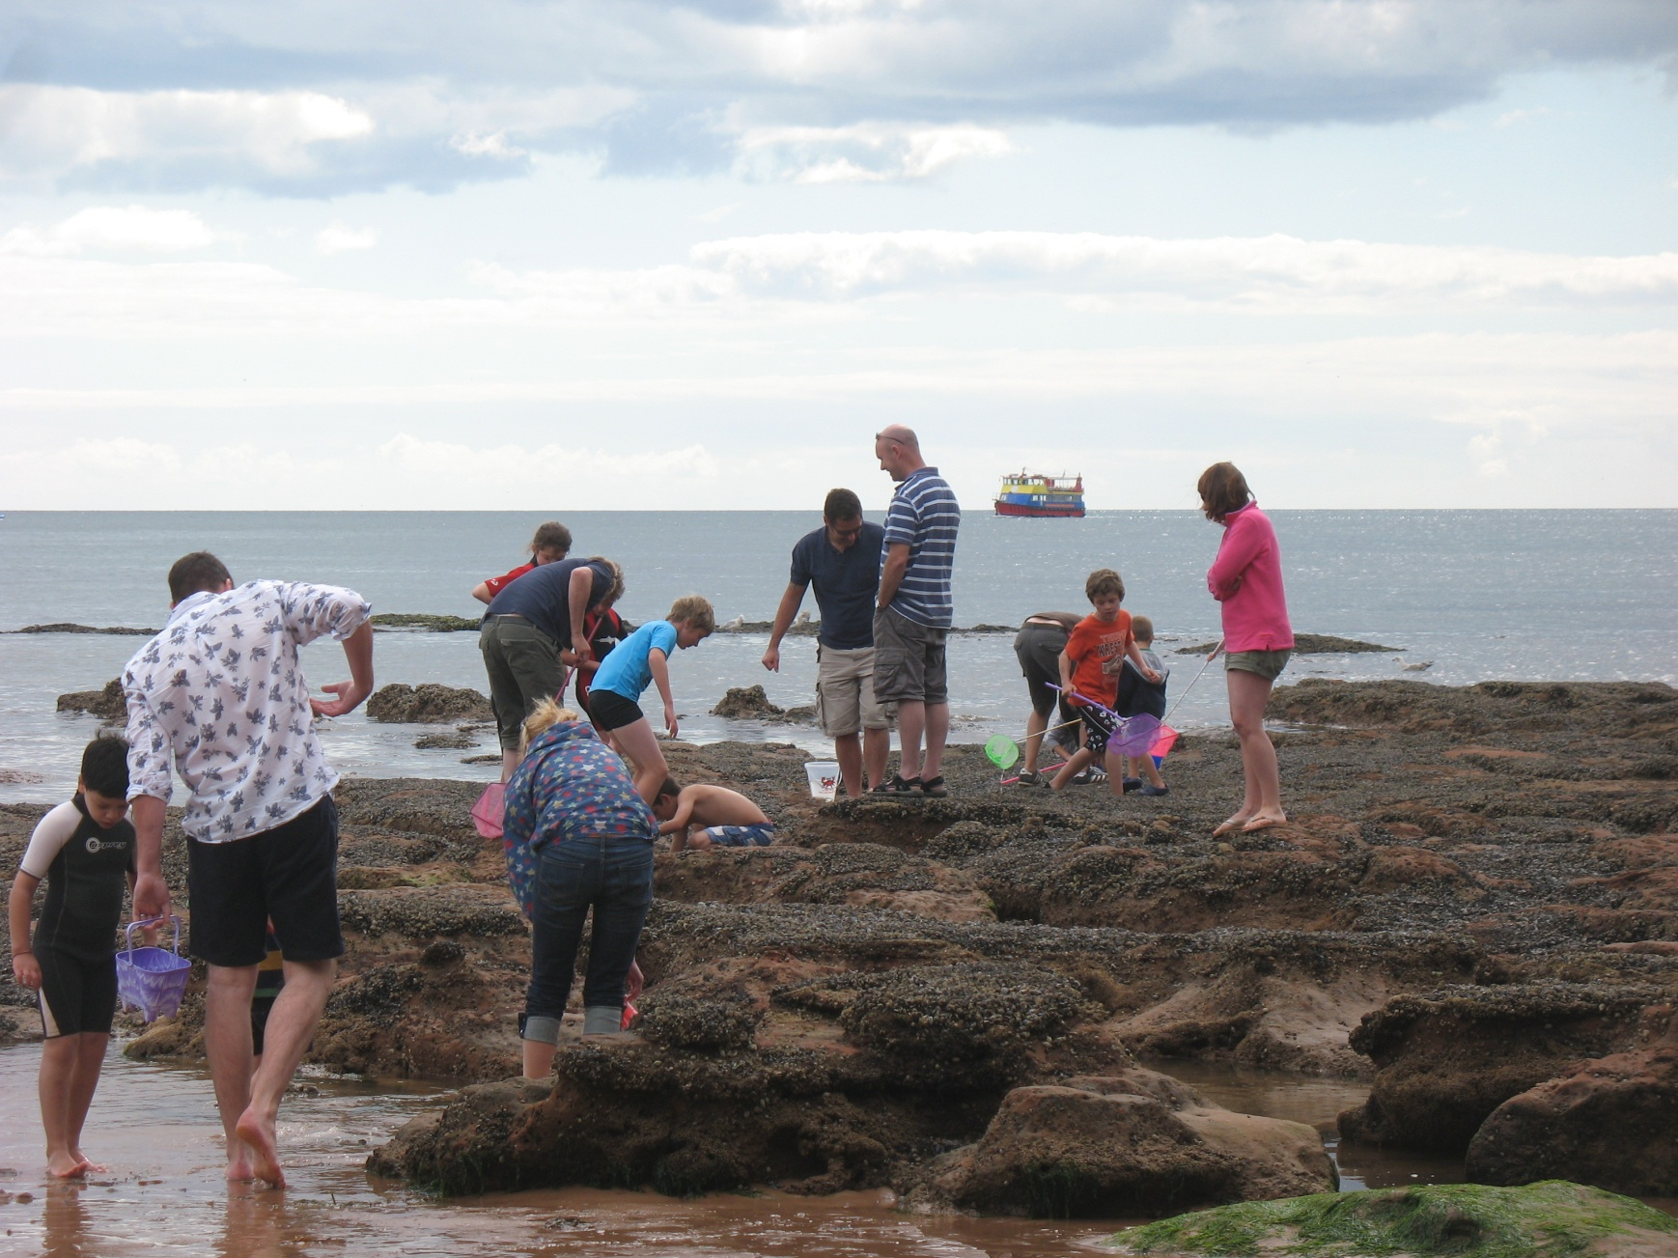
Notes:
Rock pooling at Exmouth, Devon, the rocks covered in slippery brown seaweed. What’s in the purple bucket?

Slide 8
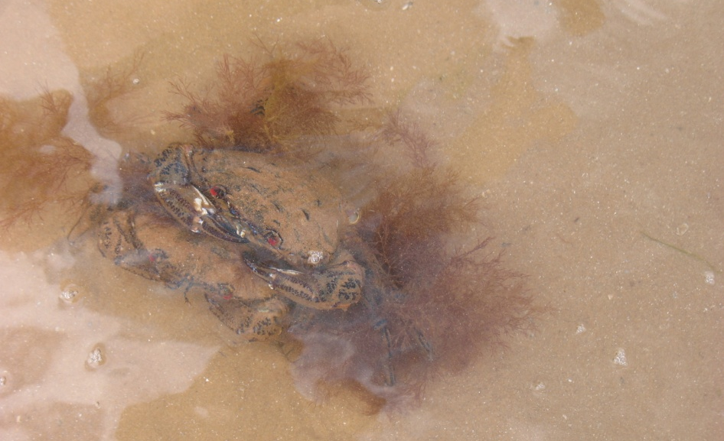
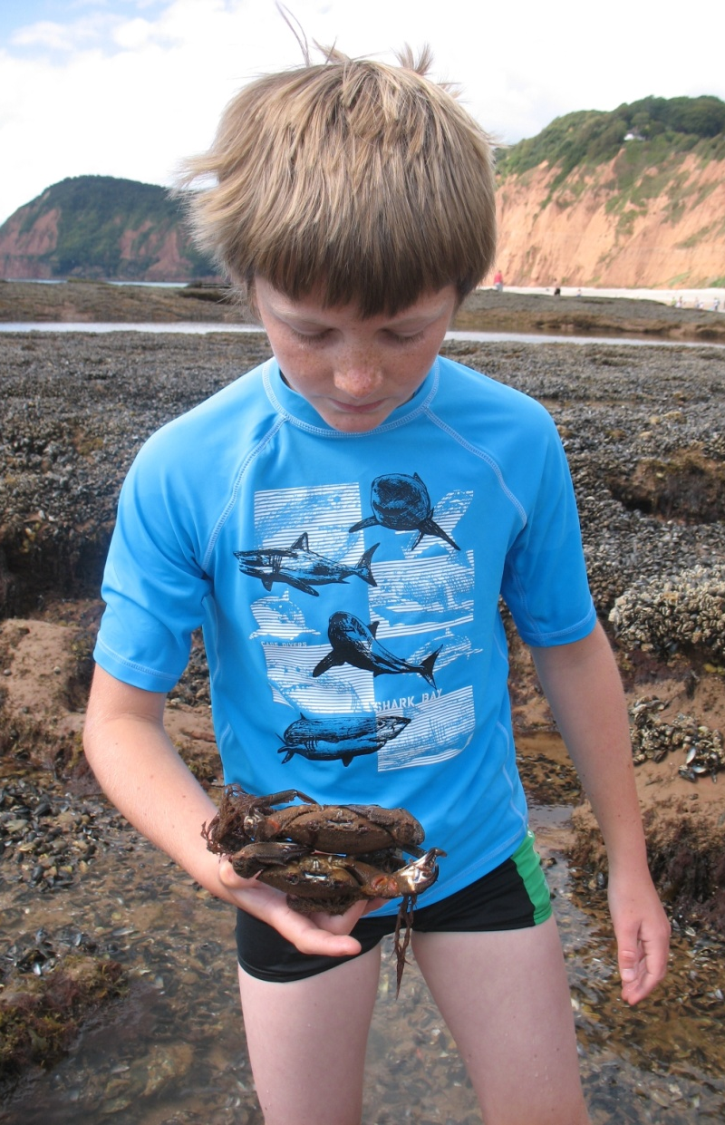
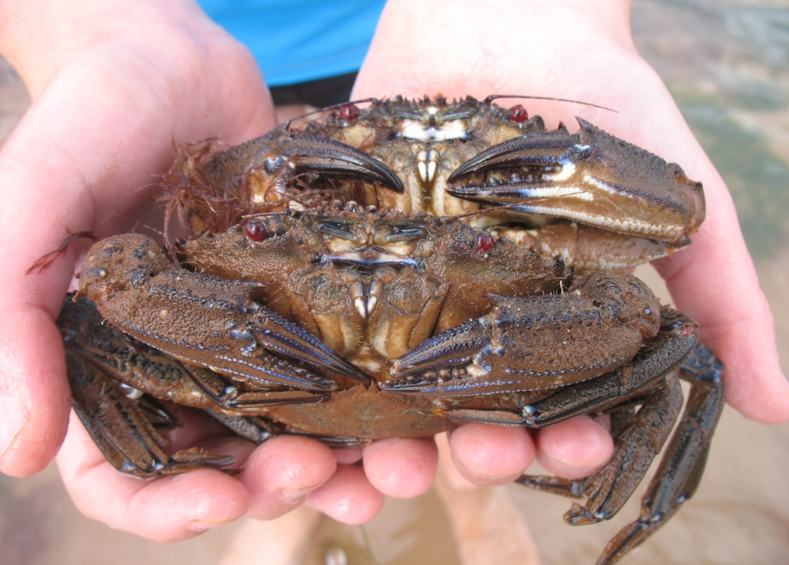
Notes:
Crabs, in and out of water, caught in the rock pools near Sidmouth, E. Devon.

Slide 9
Economic activity on coasts
Ferries – large and small, at home and abroad
Notes:
A Caledonian MacBrayne ferry, Highlands and Islands, Scotland
This vehicle ferry is at the quayside at the Isle of Tiree, Inner Hebrides. It sails from Oban, on the mainland, and calls at different islands on different days. This particular ferry had been to South Uist and Barra, Outer Hebrides and was calling in at Tiree on the way back to Oban. This sailing only happens on Thursdays.

Slide 10
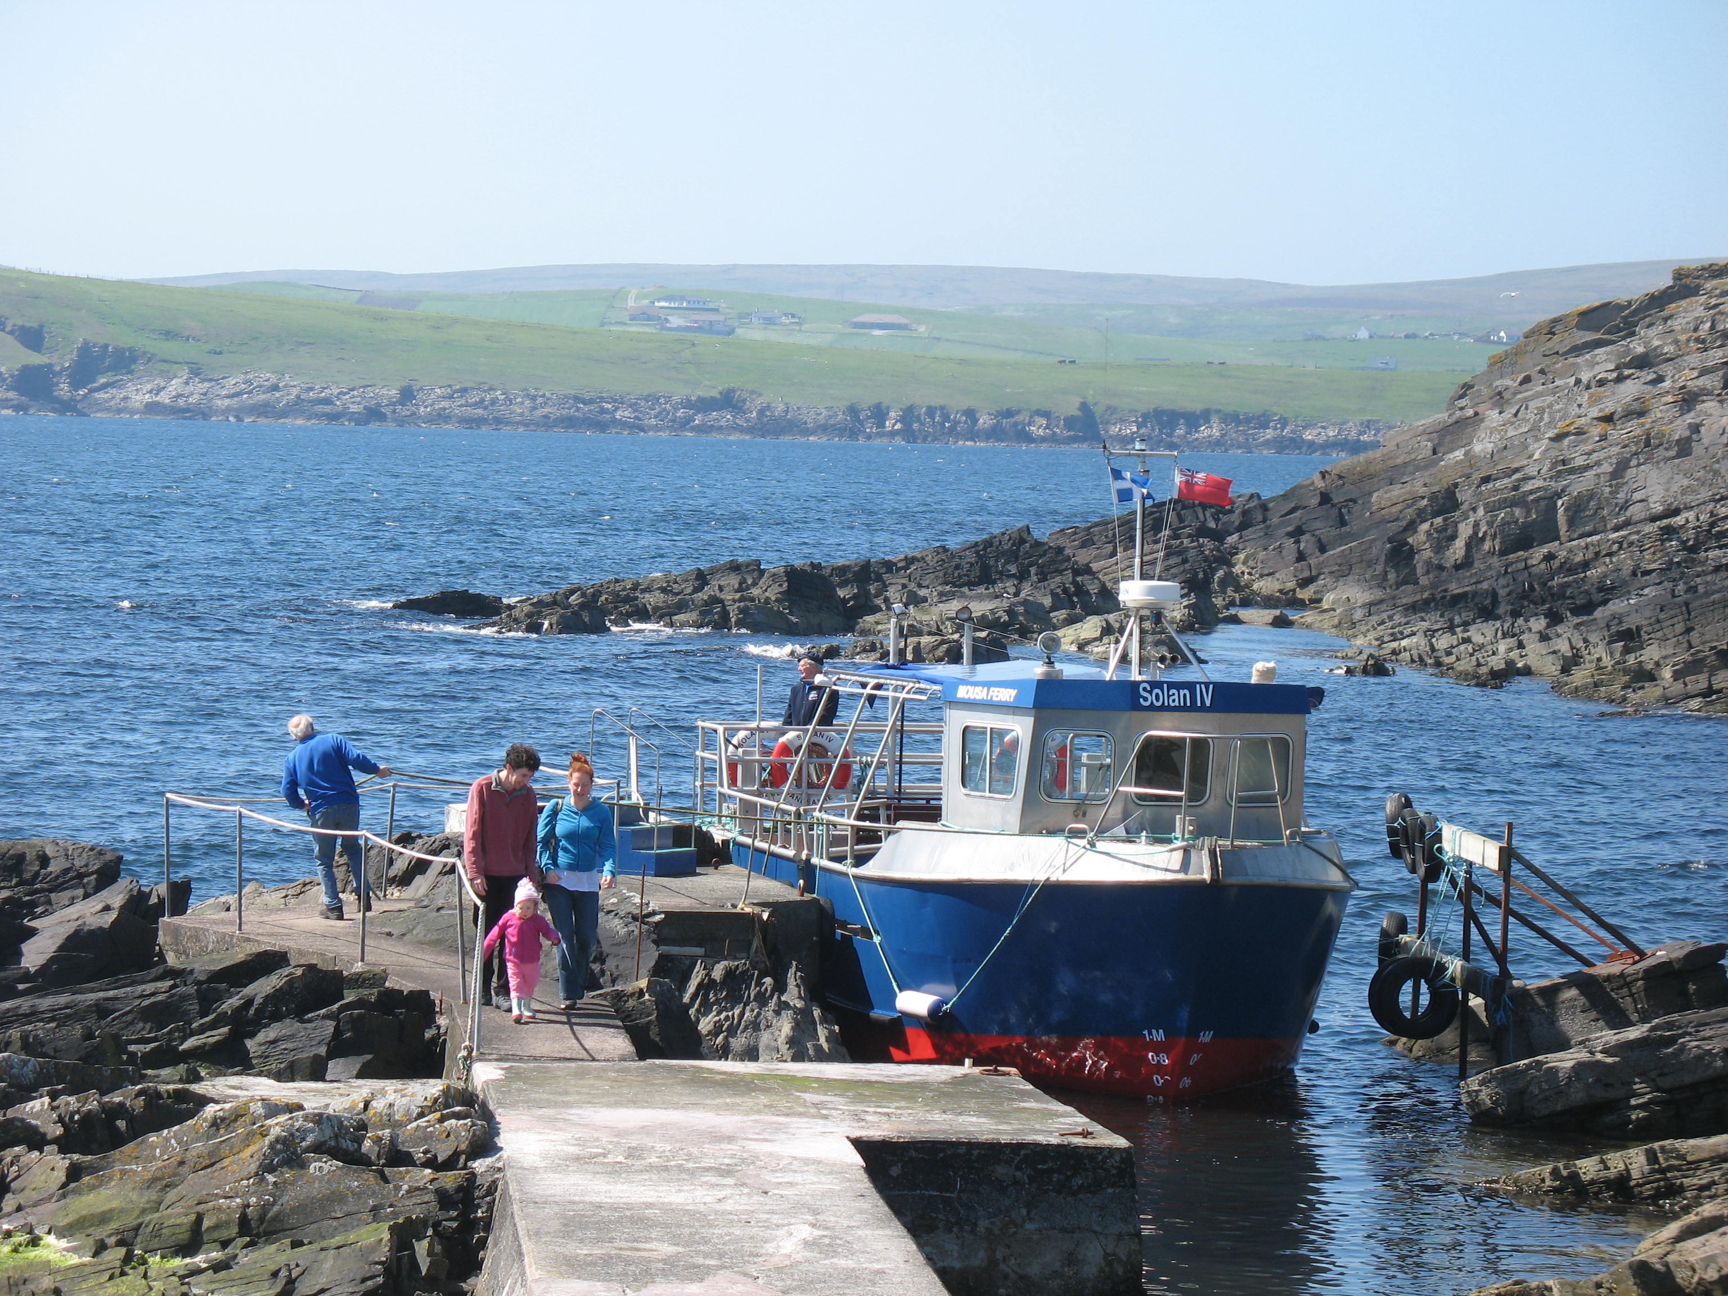
Notes:
Mousa Ferry, leaving Shetland mainland and then returning from Mousa
This small passenger ferry moored at the jetty ready to take (mostly) visitors from mainland Shetland to the small island of Mousa where there is a remains of an Iron Age ‘broch’. The purpose of brochs is disputed by archaeologists, but is possibly a fortified dwelling.
At Mousa the ferry ties up at a tiny concrete jetty across the rocks. The ferry only sails in good weather. It sometimes takes bird watchers right round the island, if conditions are suitable.

Slide 11
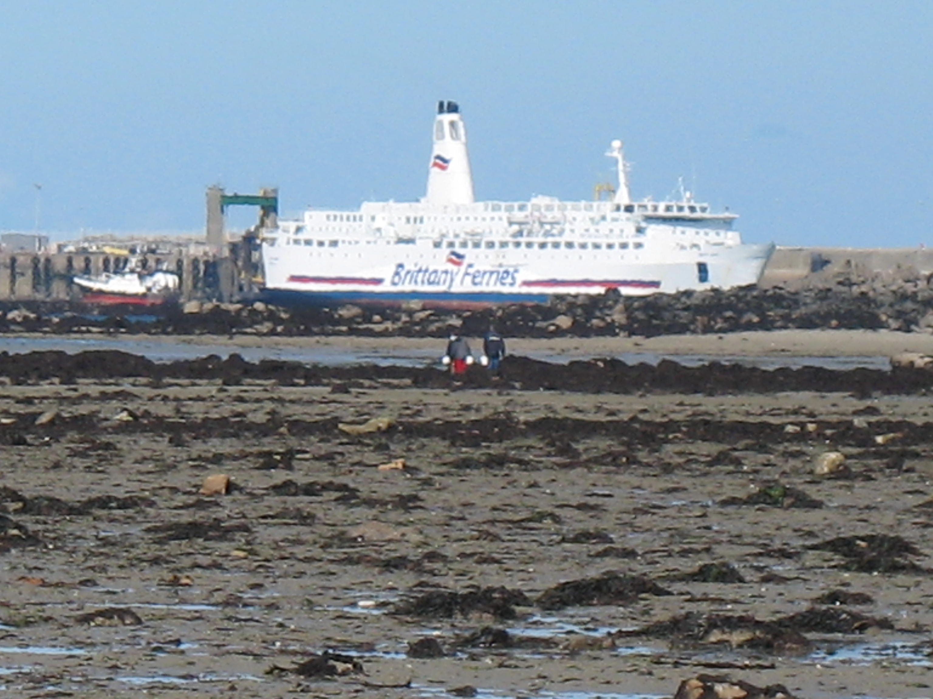
Notes:
Brittany Ferries vessel at Roscoff
The vehicle ferry sails from Plymouth to Roscoff, a journey which takes 6 hours. The tide is out so it looks as if the ferry is stuck, but there is a sufficiently deep-water channel by the quay.

